Slide 1
Movie Review Bot and Analytics
-A one tap Movie Assistant and Guide

Slide 2
What is Movie review bot?
Movie review bot is a chat bot that answers the queries related to Movies.
Simple queries like “ stranger things season 3 review” ,”Bharat movie details”,
“Box office collection of maharshi” etc.
The bot will be available through all popular channels like facebook, slack, telegram. So user can use them in their favourite chatting channel.
The fast replies from legitimate sources helps the users to choose perfect movie to watch
The bot also notifies about the new movie releases and updates, makes the users not to miss the new movies
We also provide analysis of success ratio of industries, hero’s, movies collections and Genres which helps the director for choosing the script in the most successful genre.

Slide 3
Problems with finding reviews
The entertainment and digital together ruling the generation.
90% of peoples main entertainment source is movies, webseries and watching videos.
There are number of movies, shows and series out there. In this busy life we actually do not get much time to search about movies and watch whatever the stuff is. We want the best to watch since we get very less time to watch them.
Searching in the internet, finding one and watching them really takes time and effort, since there are many sources in the internet and we don’t know which is correct.

Slide 4
Solutions
We are available at one tap in all popular social media channels, so our bot can reduce the time in searching in the internet about the stuff related to movies
We take the reviews, ratings, collections and other details from the legitimate and best source available in the internet. So Fraud reviews cannot waste your time.
We enrich details using Analytics in order to convey Info to the users in the best way
We also show the statistics which help the directors, producers and Movie Buffs.

Slide 5
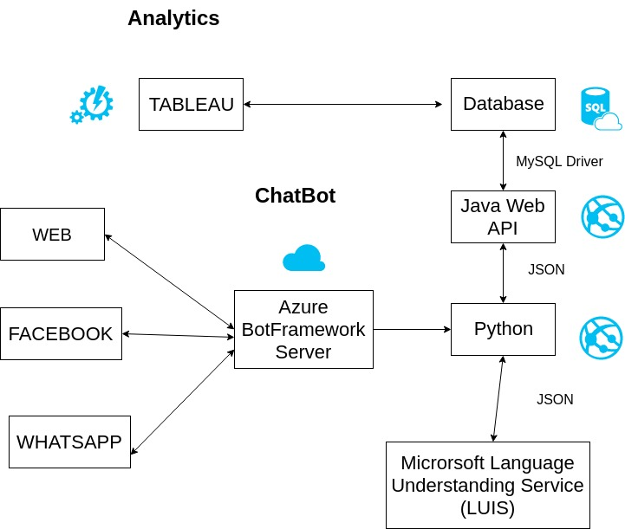
Tech Stack

Slide 6
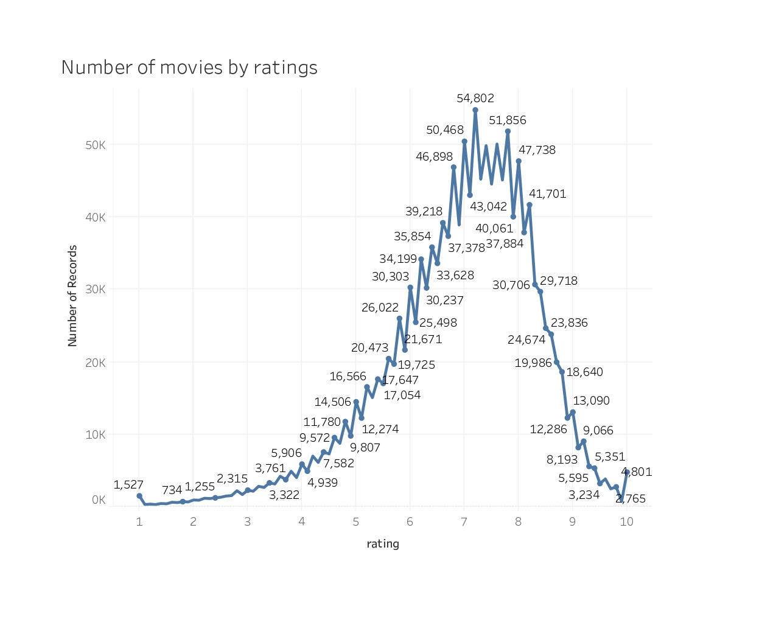
Analytics
Here, The total number movies segregated by rating are shown in a graph. The statistic shows Highest number of movies are rated at 7.
Similar Analytics can be drawn around multiple dimensions.

Slide 7
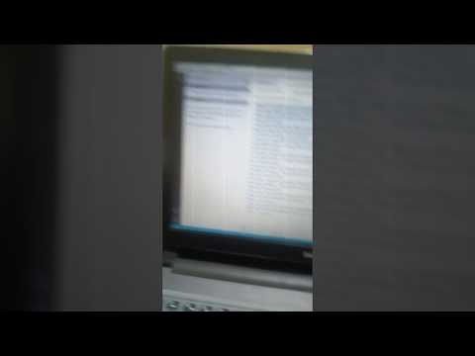
Demo

Slide 8
Thank You
From Team Movie Review Bot and Analytics

